Slide 1
Network+ Guide to Networks 7th Edition
Chapter 3
How Data Is Transported Over Networks
Notes:
Network+ Guide to Networks 7th Edition
Chapter 3
How Data Is Transported Over Networks

Slide 2
Objectives
Identify and explain the functions of the core TCP/IP protocols
Explain the purposes and properties of routing and describe common IPv4 and IPv6 routing protocols
Employ multiple TCP/IP utilities for network discovery and troubleshooting
Notes:
Objectives
Identify and explain the functions of the core TCP/IP protocols
Explain the purposes and properties of routing and describe common IPv4 and IPv6 routing protocols
Employ multiple TCP/IP utilities for network discovery and troubleshooting

Slide 3
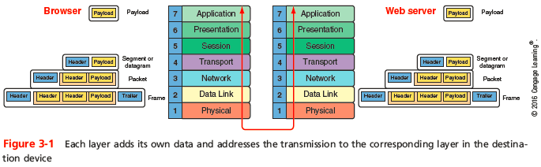
TCP/IP Core Protocols
TCP/IP - a suite of protocols including:
TCP, IP, UDP, ARP, and many others
TCP/IP is open and routable
Protocols add a header to data inherited from the layer above it
Notes:
TCP/IP Core Protocols
TCP/IP - a suite of protocols including:
TCP, IP, UDP, ARP, and many others
TCP/IP is open and routable
Protocols add a header to data inherited from the layer above it

Slide 4
TCP/IP Core Protocols
Layers 7, 6, and 5 - Data and instructions, known as payload, are generated by applications running on source host
Layer 4 - Usually TCP or UDP adds a header to the payload
Includes a port number to identify the receiving app
Layer 3 - Network layer adds it own header and becomes a packet
Layer 2 - packet is passed to Data Link layer on NIC, which encapsulates data with its own header and trailer, creating a frame
Notes:
TCP/IP Core Protocols
Layers 7, 6, and 5 - Data and instructions, known as payload, are generated by applications running on source host
Layer 4 - Usually TCP or UDP adds a header to the payload
Includes a port number to identify the receiving app
Layer 3 - Network layer adds it own header and becomes a packet
Layer 2 - packet is passed to Data Link layer on NIC, which encapsulates data with its own header and trailer, creating a frame

Slide 5
TCP/IP Core Protocols
Layer 1 - Physical layer on the NIC receives the frame and places the transmission on the network
Receiving host de-encapsulates the message at each layer in reverse order and presents payload to the receiving applications
Connectivity devices are specialized devices that allow two or more networks or multiple parts of one network to connect and exchange data
Known by the highest OSI layer they read and process
Notes:
TCP/IP Core Protocols
Layer 1 - Physical layer on the NIC receives the frame and places the transmission on the network
Receiving host de-encapsulates the message at each layer in reverse order and presents payload to the receiving applications
Connectivity devices are specialized devices that allow two or more networks or multiple parts of one network to connect and exchange data
Known by the highest OSI layer they read and process

Slide 6
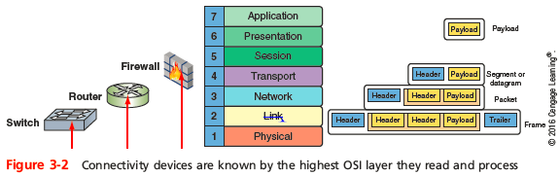
TCP/IP Core Protocols
Notes:
TCP/IP Core Protocols

Slide 7
TCP (Transmission Control Protocol)
TCP operates in the Transport layer of OSI model
Three characteristics of TCP
Connection-oriented protocol - TCP ensures that a connection or session is established by using a three-step process called a three-way handshake
Sequencing and checksums - TCP sends a character string called a checksum that is checked by the destination host along with a sequence number for each segment
Flow control - gauges rate of transmission based on how quickly recipient can accept data
Notes:
TCP (Transmission Control Protocol)
TCP operates in the Transport layer of OSI model
Three characteristics of TCP
Connection-oriented protocol - TCP ensures that a connection or session is established by using a three-step process called a three-way handshake
Sequencing and checksums - TCP sends a character string called a checksum that is checked by the destination host along with a sequence number for each segment
Flow control - gauges rate of transmission based on how quickly recipient can accept data

Slide 8
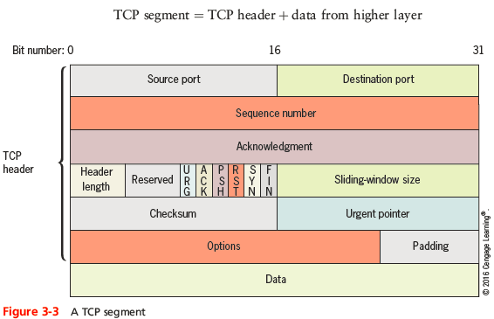
Fields in a TCP Segment
Notes:
Fields in a TCP Segment

Slide 9
TCP Three-Way Handshake
Three transmission sent before data transmission:
Step 1 - request for a connection (SYN)
Step 2 - response to the request (SYN/ACK)
Step 3 - connection established (ACK)
After the three initial messages, the payload or data is sent
Sequence numbers will be increased by the number of bits included in each received segment
Confirms the correct length of message was received
Notes:
TCP Three-Way Handshake
Three transmission sent before data transmission:
Step 1 - request for a connection (SYN)
Step 2 - response to the request (SYN/ACK)
Step 3 - connection established (ACK)
After the three initial messages, the payload or data is sent
Sequence numbers will be increased by the number of bits included in each received segment
Confirms the correct length of message was received

Slide 10
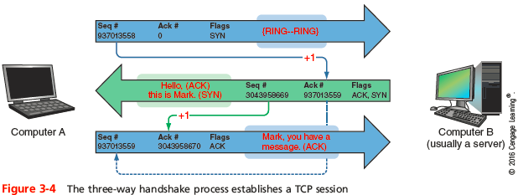
TCP Three-Way Handshake
Notes:
TCP Three-Way Handshake

Slide 11
UDP (User Datagram Protocol)
UDP provides no error checking or sequencing
Makes UDP more efficient than TCP
Useful for live audio or video transmissions over the Internet
Also more efficient for carrying messages that fit within one data packet
A UDP header contains only four fields: Source port, Destination port, Length, and Checksum
Use of Checksum field in UDP is optional in IPv4, but required in IPv6
Notes:
UDP (User Datagram Protocol)
UDP provides no error checking or sequencing
Makes UDP more efficient than TCP
Useful for live audio or video transmissions over the Internet
Also more efficient for carrying messages that fit within one data packet
A UDP header contains only four fields: Source port, Destination port, Length, and Checksum
Use of Checksum field in UDP is optional in IPv4, but required in IPv6

Slide 12
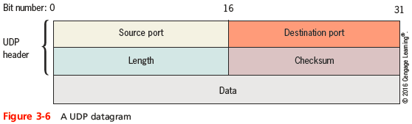
UDP (User Datagram Protocol)
Notes:
UDP (User Datagram Protocol)

Slide 13
IP (Internet Protocol)
IP operates at the Network layer of the OSI model
Specifies how and where data should be delivered
IP enables TCP/IP to internetwork
Traverse more than one LAN segment and more than one type of network through a router
IP is an unreliable, connectionless protocol
Means that IP does not guarantee delivery of data and no connection is established before data is transmitted
IP depends on TCP to ensure data packets are delivered to the right address
Notes:
IP (Internet Protocol)
IP operates at the Network layer of the OSI model
Specifies how and where data should be delivered
IP enables TCP/IP to internetwork
Traverse more than one LAN segment and more than one type of network through a router
IP is an unreliable, connectionless protocol
Means that IP does not guarantee delivery of data and no connection is established before data is transmitted
IP depends on TCP to ensure data packets are delivered to the right address

Slide 14
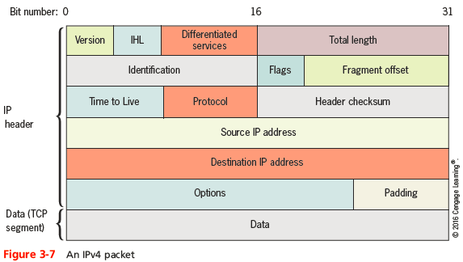
IPv4 Packets
Notes:
IPv4 Packets

Slide 15
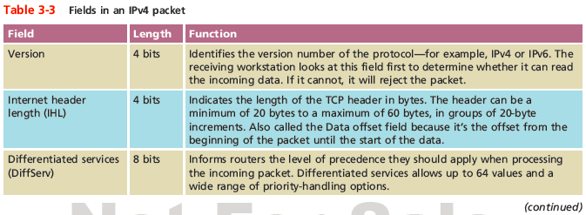
IPv4 Packets
Notes:
IPv4 Packets

Slide 16
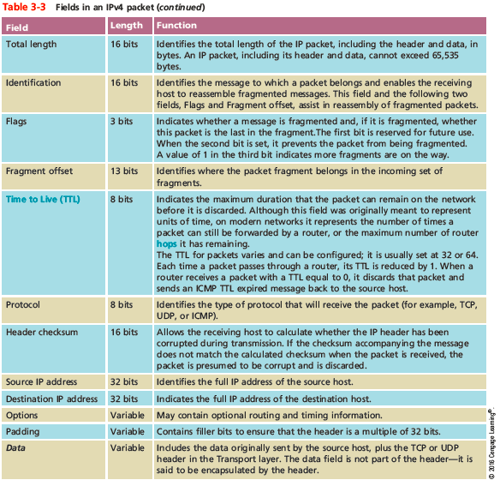
IPv4 Packets
Notes:
IPv4 Packets

Slide 17
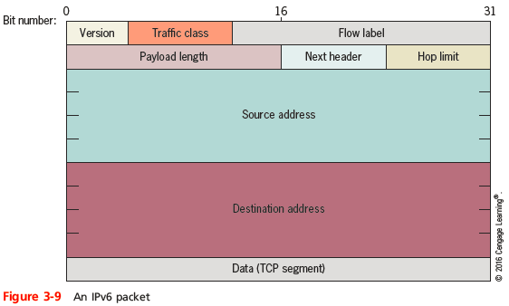
IPv6 Packets
Notes:
IPv6 Packets

Slide 18
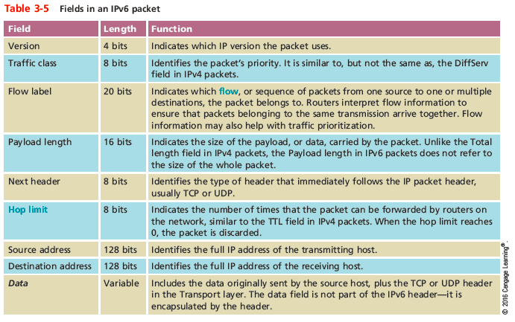
IPv6 Packets
Notes:
IPv6 Packets

Slide 19
ICMP (Internet Control Message Protocol)
ICMP - a Network layer core protocol that reports one the success or failure of data delivery
ICMP can indicate when:
Part of a network is congested
Data fails to reach its destination
Data has been discarded when the TTL has expired
ICMP announces transmission failures to sender but does not correct errors it detects
ICMPv6 on IPV6 networks performs the functions of IGMP and ARP on IPv4 networks
Notes:
ICMP (Internet Control Message Protocol)
ICMP - a Network layer core protocol that reports one the success or failure of data delivery
ICMP can indicate when:
Part of a network is congested
Data fails to reach its destination
Data has been discarded when the TTL has expired
ICMP announces transmission failures to sender but does not correct errors it detects
ICMPv6 on IPV6 networks performs the functions of IGMP and ARP on IPv4 networks

Slide 20
IGMP (Internet Group Management Protocol) on IPv4 Networks
IGMP operates at the Network layer of OSI model to manage multicasting
Multicasting can be used for teleconferencing or videoconferencing over the Internet
Routers use IGMP to determine which nodes belong to a certain multicast group
And to transmit data to all nodes in that group
Network nodes use IGMP to join or leave multicast groups at any time
Notes:
IGMP (Internet Group Management Protocol) on IPv4 Networks
IGMP operates at the Network layer of OSI model to manage multicasting
Multicasting can be used for teleconferencing or videoconferencing over the Internet
Routers use IGMP to determine which nodes belong to a certain multicast group
And to transmit data to all nodes in that group
Network nodes use IGMP to join or leave multicast groups at any time

Slide 21
ARP (Address Resolution Protocol) on IPv4 Networks
ARP works in conjunction with IPv4 to discover the MAC address of a host or node on the local network
And to maintain a database that maps IP addresses to MAC addresses on the local network
ARP is a Layer 2 protocol that uses IP in Layer 3
Operates only within its local network
ARP relies on broadcasting
ARP table - the database of IP-to-MAC address mappings
Notes:
ARP (Address Resolution Protocol) on IPv4 Networks
ARP works in conjunction with IPv4 to discover the MAC address of a host or node on the local network
And to maintain a database that maps IP addresses to MAC addresses on the local network
ARP is a Layer 2 protocol that uses IP in Layer 3
Operates only within its local network
ARP relies on broadcasting
ARP table - the database of IP-to-MAC address mappings

Slide 22
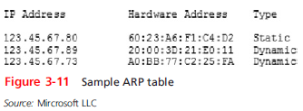
ARP (Address Resolution Protocol) on IPv4 Networks
Notes:
ARP (Address Resolution Protocol) on IPv4 Networks

Slide 23
ARP (Address Resolution Protocol) on IPv4 Networks
An ARP table can contain two types of entries:
Dynamic - created when a client makes an ARP request that could not be satisfied by data already in the ARP table
Static - those someone entered manually using the ARP utility (arp command)
To view a Window’s workstation’s ARP table, enter the command:
arp -a
Notes:
ARP (Address Resolution Protocol) on IPv4 Networks
An ARP table can contain two types of entries:
Dynamic - created when a client makes an ARP request that could not be satisfied by data already in the ARP table
Static - those someone entered manually using the ARP utility (arp command)
To view a Window’s workstation’s ARP table, enter the command:
arp -a

Slide 24
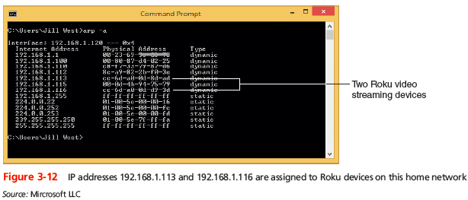
ARP (Address Resolution Protocol) on IPv4 Networks
Notes:
ARP (Address Resolution Protocol) on IPv4 Networks

Slide 25
Routers and How They Work
A router joins two or more networks and passes packets from one network to another
Routers can do the following:
Connect dissimilar networks (LANs and WANs)
Interpret Layer 3 and often Layer 4 addressing
Determine the best path for data to follow from point A to point B
Reroute traffic if the path of first choice is down but another path is available
Notes:
Routers and How They Work
A router joins two or more networks and passes packets from one network to another
Routers can do the following:
Connect dissimilar networks (LANs and WANs)
Interpret Layer 3 and often Layer 4 addressing
Determine the best path for data to follow from point A to point B
Reroute traffic if the path of first choice is down but another path is available

Slide 26
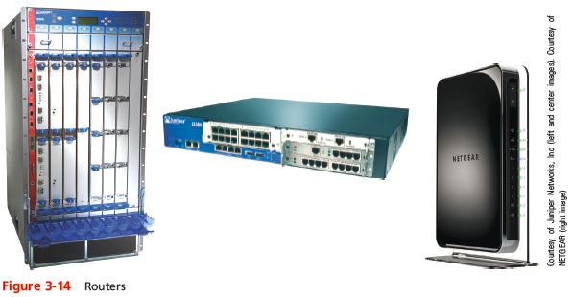
Routers and How They Work
Notes:
Routers and How They Work

Slide 27
Routers and How They Work
Routers may perform any of the following optional functions:
Filter broadcast transmissions
Prevent certain types of traffic from getting to a network
Support simultaneous local and remote connectivity
Provide high network fault tolerance through redundant components such as power supplies
Monitor network traffic and report statistics
Diagnose internal or other connectivity problems and trigger alarms
Notes:
Routers and How They Work
Routers may perform any of the following optional functions:
Filter broadcast transmissions
Prevent certain types of traffic from getting to a network
Support simultaneous local and remote connectivity
Provide high network fault tolerance through redundant components such as power supplies
Monitor network traffic and report statistics
Diagnose internal or other connectivity problems and trigger alarms

Slide 28
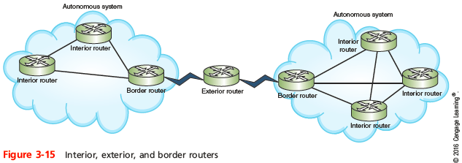
Routers and How They Work
Router categories:
Interior routers - direct data between networks within the same autonomous system
Border routers - connect an autonomous system with an outside network
Exterior routers - direct data between autonomous systems
Notes:
Routers and How They Work
Router categories:
Interior routers - direct data between networks within the same autonomous system
Border routers - connect an autonomous system with an outside network
Exterior routers - direct data between autonomous systems

Slide 29
Multilayer Switches
Layer 3 switch - capable of interpreting Layer 3 data and works much like a router
Primary difference is the way the hardware is built and they are faster and less expensive than routers
Layer 4 switch - capable of interpreting Layer 4 data
Also known as content or application switches
Enables switch to perform advanced filtering, keep statistics, and provide security functions
Typically used as part of a network’s backbone
Notes:
Multilayer Switches
Layer 3 switch - capable of interpreting Layer 3 data and works much like a router
Primary difference is the way the hardware is built and they are faster and less expensive than routers
Layer 4 switch - capable of interpreting Layer 4 data
Also known as content or application switches
Enables switch to perform advanced filtering, keep statistics, and provide security functions
Typically used as part of a network’s backbone

Slide 30
Routing Tables
Routing table - a database that maintains information about where hosts are located and the most efficient way to reach them
Routers rely on them to identify which router is the next hop to reach a particular destination host
Routing tables contain IP addresses and network masks that identify a network that a host or another router belongs to
Notes:
Routing Tables
Routing table - a database that maintains information about where hosts are located and the most efficient way to reach them
Routers rely on them to identify which router is the next hop to reach a particular destination host
Routing tables contain IP addresses and network masks that identify a network that a host or another router belongs to

Slide 31
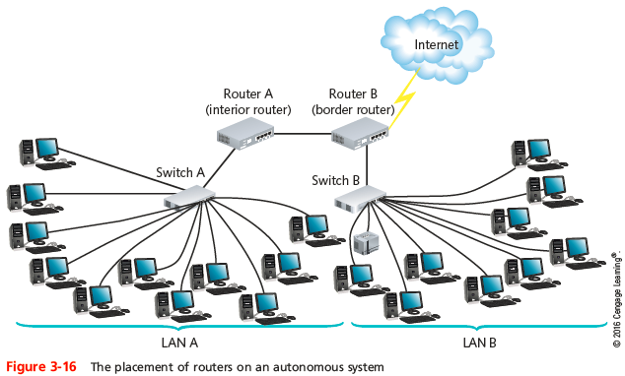
Routing Tables
Notes:
Routing Tables

Slide 32
Static or Dynamic Routing
Static routing - network administrators configures a routing table to direct messages along specific paths
Example - a static route between a small business and its ISP
Dynamic routing - automatically calculates the best path between two networks and maintains this information in a routing table
Router can detect problems with failed or congested routes and reroute messages through a different path
Gateway of last resort - a router that accepts all unroutable messages from other routers
Notes:
Static or Dynamic Routing
Static routing - network administrators configures a routing table to direct messages along specific paths
Example - a static route between a small business and its ISP
Dynamic routing - automatically calculates the best path between two networks and maintains this information in a routing table
Router can detect problems with failed or congested routes and reroute messages through a different path
Gateway of last resort - a router that accepts all unroutable messages from other routers

Slide 33
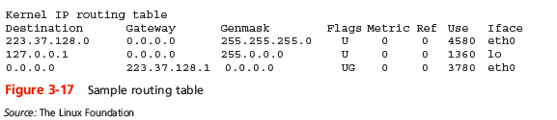
The route Command
The route command allows you to view a host’s routing table
On a Windows-based system, use the command route print
On a Cisco-brand router, use the command show ip route
Notes:
The route Command
The route command allows you to view a host’s routing table
On a Windows-based system, use the command route print
On a Cisco-brand router, use the command show ip route

Slide 34
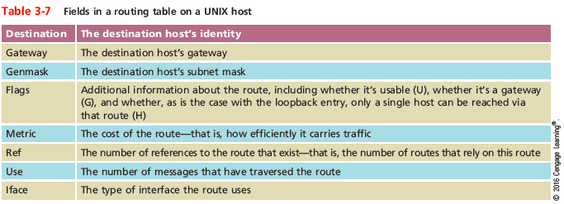
The route Command
Notes:
The route Command

Slide 35
Routing Metrics
Routing metrics - properties of a route used by routers to determine the best path to a destination:
Hop count
Theoretical bandwidth and actual throughput
Delay, or latency, on a potential path
Load, or the traffic or processing burden
MTU (maximum transmission unit), or the largest IP packet size in bytes allowable without fragmentation
Routing cost, or a value assigned to a particular route
Reliability of a potential path
Topology of a network
Notes:
Routing Metrics
Routing metrics - properties of a route used by routers to determine the best path to a destination:
Hop count
Theoretical bandwidth and actual throughput
Delay, or latency, on a potential path
Load, or the traffic or processing burden
MTU (maximum transmission unit), or the largest IP packet size in bytes allowable without fragmentation
Routing cost, or a value assigned to a particular route
Reliability of a potential path
Topology of a network

Slide 36
Routing Protocols
Routing protocols - used by routers to communicate with each other to determine the best path
Routers rate the reliability and priority of a routing protocol’s data based on these criteria:
Administrative distance (AD) - a number indicating the protocol’s reliability
Convergence time - time it takes to recognize a best path in the event of a change or network outage
Overhead - the burden placed on the underlying network to support the protocol
Notes:
Routing Protocols
Routing protocols - used by routers to communicate with each other to determine the best path
Routers rate the reliability and priority of a routing protocol’s data based on these criteria:
Administrative distance (AD) - a number indicating the protocol’s reliability
Convergence time - time it takes to recognize a best path in the event of a change or network outage
Overhead - the burden placed on the underlying network to support the protocol

Slide 37
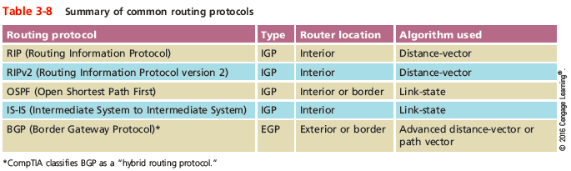
Routing Protocols
Notes:
Routing Protocols

Slide 38
Interior and Exterior Gateway Routing Protocols
IGP (interior gateway protocols) - used by interior routers and border routers within autonomous systems and are often grouped according to the algorithms they use to calculate best paths:
Distance-vector routing protocols
Link-state routing protocols
EGP (exterior gateway protocols) - used by border routers and exterior routers to distribute data outside of autonomous systems
The only EGP currently in use is BGP
Notes:
Interior and Exterior Gateway Routing Protocols
IGP (interior gateway protocols) - used by interior routers and border routers within autonomous systems and are often grouped according to the algorithms they use to calculate best paths:
Distance-vector routing protocols
Link-state routing protocols
EGP (exterior gateway protocols) - used by border routers and exterior routers to distribute data outside of autonomous systems
The only EGP currently in use is BGP

Slide 39
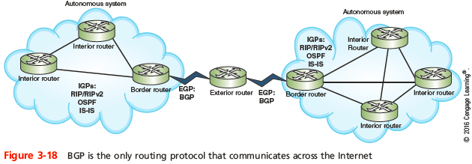
Interior and Exterior Gateway Routing Protocols
Notes:
Interior and Exterior Gateway Routing Protocols

Slide 40
Interior and Exterior Gateway Routing Protocols
OSPF (Open Shortest Path First) - an IGP and a link-state protocol used on interior or border routers
Introduced as an improvement to RIP
Imposes no hop limits (unlike RIP)
Uses a more complex algorithm for determining best paths
Demands more memory and CPU power than RIP, but keeps network bandwidth to a minimum and provides a very fast convergence time
Notes:
Interior and Exterior Gateway Routing Protocols
OSPF (Open Shortest Path First) - an IGP and a link-state protocol used on interior or border routers
Introduced as an improvement to RIP
Imposes no hop limits (unlike RIP)
Uses a more complex algorithm for determining best paths
Demands more memory and CPU power than RIP, but keeps network bandwidth to a minimum and provides a very fast convergence time

Slide 41
Interior and Exterior Gateway Routing Protocols
IS-IS (Intermediate System to Intermediate System) - an IGP and link-state routing protocol
Uses a best-path algorithm similar to OSPF’s
Is designed for use on interior routers only (unlike OSPF)
Not handcuffed to IPv4 (like OSPF) so it’s easy to adapt to IPv6
Service providers generally prefer IS-IS because it’s more scalable than OSPF
Notes:
Interior and Exterior Gateway Routing Protocols
IS-IS (Intermediate System to Intermediate System) - an IGP and link-state routing protocol
Uses a best-path algorithm similar to OSPF’s
Is designed for use on interior routers only (unlike OSPF)
Not handcuffed to IPv4 (like OSPF) so it’s easy to adapt to IPv6
Service providers generally prefer IS-IS because it’s more scalable than OSPF

Slide 42
Interior and Exterior Gateway Routing Protocols
BGP (Border Gateway Protocol) - the only current EGP and is known as the “protocol of the Internet”
Can span multiple autonomous systems
A path-vector routing protocol that communicates via BGP-specific messages that travel between routers
Can be configured to follow policies that might avoid a certain router or instruct a group of routers to prefer a particular route
The most complex of the routing protocols
Uses an autonomous system number (ASN) to identify networks
Notes:
Interior and Exterior Gateway Routing Protocols
BGP (Border Gateway Protocol) - the only current EGP and is known as the “protocol of the Internet”
Can span multiple autonomous systems
A path-vector routing protocol that communicates via BGP-specific messages that travel between routers
Can be configured to follow policies that might avoid a certain router or instruct a group of routers to prefer a particular route
The most complex of the routing protocols
Uses an autonomous system number (ASN) to identify networks

Slide 43
Troubleshooting Router Issues
TCP/IP comes with a set of utilities that can help track down most TCP/IP related problems
You should be familiar with the following tools and their parameters:
netstat
nbtstat
tracert or traceroute
pathping
Notes:
Troubleshooting Router Issues
TCP/IP comes with a set of utilities that can help track down most TCP/IP related problems
You should be familiar with the following tools and their parameters:
netstat
nbtstat
tracert or traceroute
pathping

Slide 44
Troubleshooting Tools
netstat - displays TCP/IP statistics and details about TCP/IP components/connections on a host
Information that can be obtained from the netstat command includes:
The port on which a particular TCP/IP service is running
Which network connections are currently established for a client
How many messages have been handled by a network interface since it was activated
How many data errors have occurred on a particular network interface
Notes:
Troubleshooting Tools
netstat - displays TCP/IP statistics and details about TCP/IP components/connections on a host
Information that can be obtained from the netstat command includes:
The port on which a particular TCP/IP service is running
Which network connections are currently established for a client
How many messages have been handled by a network interface since it was activated
How many data errors have occurred on a particular network interface

Slide 45
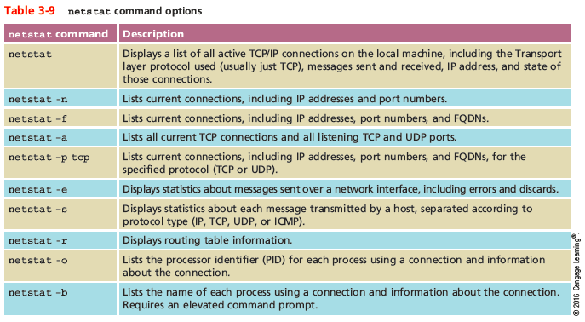
Troubleshooting Tools
Notes:
Troubleshooting Tools

Slide 46
Troubleshooting Tools
nbtstat - provides information about NetBIOS statistics and resolve NetBIOS names to their IP addresses
If you know the NetBIOS name of a workstation, you can use nbtstat to determine its IP address
NetBIOS is a Windows protocol that was once an alternative to TCP/IP
Mostly used by legacy applications
Notes:
Troubleshooting Tools
nbtstat - provides information about NetBIOS statistics and resolve NetBIOS names to their IP addresses
If you know the NetBIOS name of a workstation, you can use nbtstat to determine its IP address
NetBIOS is a Windows protocol that was once an alternative to TCP/IP
Mostly used by legacy applications

Slide 47
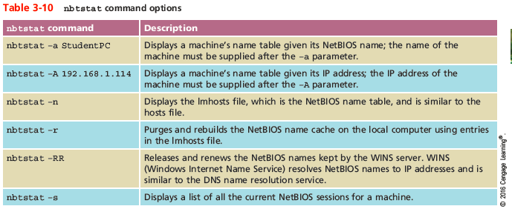
Troubleshooting Tools
Notes:
Troubleshooting Tools

Slide 48
Troubleshooting Tools
tracert or traceroute -
Windows tracert utility uses ICMP echo requests to trace the path from one networked node to another, identifying all intermediate hops between the nodes
Linux, UNIX, and OS X system use the traceroute utility to send UDP messages to a random port on the destination node (concept is the same as tracert)
Both utilities employ a trial-and-error approach to discover the nodes at each hop from source to destination
Notes:
Troubleshooting Tools
tracert or traceroute -
Windows tracert utility uses ICMP echo requests to trace the path from one networked node to another, identifying all intermediate hops between the nodes
Linux, UNIX, and OS X system use the traceroute utility to send UDP messages to a random port on the destination node (concept is the same as tracert)
Both utilities employ a trial-and-error approach to discover the nodes at each hop from source to destination

Slide 49
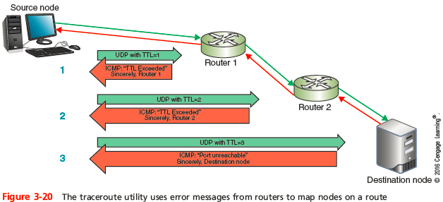
Troubleshooting Tools
Notes:
Troubleshooting Tools

Slide 50
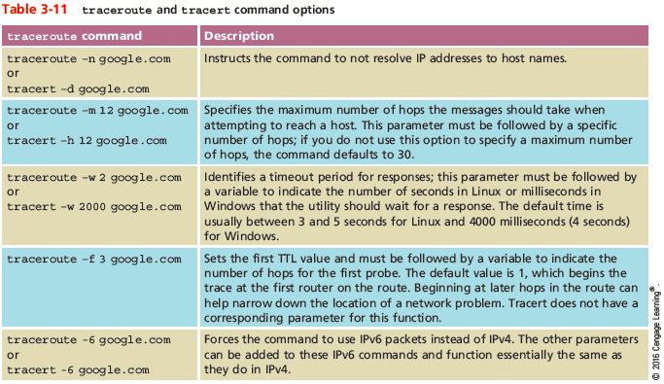
Troubleshooting Tools
Notes:
Troubleshooting Tools

Slide 51
Troubleshooting Tools
tracert or traceroute (cont’d) -
A trace test might stop before reaching the destination for one of three reasons:
The device the trace is attempting to reach is down
It’s too busy to process lower-priority messages such as UDP or ICMP
It does not accept the UDP or ICMP transmissions being sent because a firewall blocks these types of messages
A trace cannot detect router configuration problems or predict variations of routes over a period of time
Notes:
Troubleshooting Tools
tracert or traceroute (cont’d) -
A trace test might stop before reaching the destination for one of three reasons:
The device the trace is attempting to reach is down
It’s too busy to process lower-priority messages such as UDP or ICMP
It does not accept the UDP or ICMP transmissions being sent because a firewall blocks these types of messages
A trace cannot detect router configuration problems or predict variations of routes over a period of time

Slide 52
Troubleshooting Tools
pathping - a Windows utility that combines elements of both ping and tracert to provide deeper information about network issues along a route
Sends multiple pings to each hope along a route, then compiles information into a single report
A disadvantage of pathping is the amount of time it takes to run
Shorten running type by limiting the number of queries per hop with the -q parameter
Notes:
Troubleshooting Tools
pathping - a Windows utility that combines elements of both ping and tracert to provide deeper information about network issues along a route
Sends multiple pings to each hope along a route, then compiles information into a single report
A disadvantage of pathping is the amount of time it takes to run
Shorten running type by limiting the number of queries per hop with the -q parameter

Slide 53
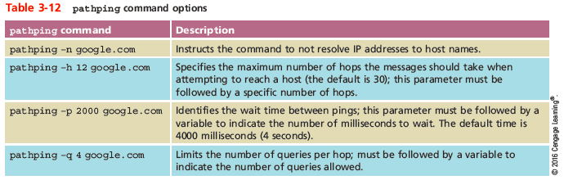
Troubleshooting Tools
Notes:
Troubleshooting Tools

Slide 54
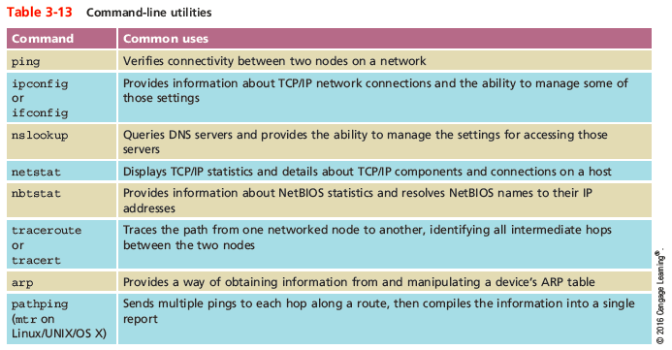
Solving Common Routing Problems
Notes:
Solving Common Routing Problems

Slide 55
Solving Common Routing Problems
Interface Errors - occur when a logical (not physical) connection between a node and a network is malfunctioning
Two important guidelines when dealing with this problem:
The ping command is a great place to start
The netstat command can give you a list of interfaces on a device, and then can be used to troubleshoot network interface errors
Notes:
Solving Common Routing Problems
Interface Errors - occur when a logical (not physical) connection between a node and a network is malfunctioning
Two important guidelines when dealing with this problem:
The ping command is a great place to start
The netstat command can give you a list of interfaces on a device, and then can be used to troubleshoot network interface errors

Slide 56
Solving Common Routing Problems
Hardware Failure - when a router, switch, NIC, or other hardware goes down
Use tracert or traceroute to track down malfunctioning routers and other devices on larger networks
Get more accurate trace feedback on a questionable router by targeting a node on the other side of that router, rather than aiming for that router itself
Notes:
Solving Common Routing Problems
Hardware Failure - when a router, switch, NIC, or other hardware goes down
Use tracert or traceroute to track down malfunctioning routers and other devices on larger networks
Get more accurate trace feedback on a questionable router by targeting a node on the other side of that router, rather than aiming for that router itself

Slide 57
Solving Common Routing Problems
Discovering Neighbor Devices - a process used by routers to learn about all of the devices on their networks
On IPv4 networks, neighbor discovery is managed by ARP with help from ICMP
IPv6 devices use Neighbor Discovery Protocol (NDP) to automatically detect neighboring devices and automatically adjust when neighboring nodes fail or are removed
Eliminates the need for ARP and ICMP functions in IPv6 networks
Notes:
Solving Common Routing Problems
Discovering Neighbor Devices - a process used by routers to learn about all of the devices on their networks
On IPv4 networks, neighbor discovery is managed by ARP with help from ICMP
IPv6 devices use Neighbor Discovery Protocol (NDP) to automatically detect neighboring devices and automatically adjust when neighboring nodes fail or are removed
Eliminates the need for ARP and ICMP functions in IPv6 networks

Slide 58
Solving Common Routing Problems
Path MTU Black Hole - messages are being lost for no apparent reason
If suspected, use the ping command to determine the largest size message that can successfully traverse a path to its destination
Adjust the buffer size of the ICMP echo message
Start with a smaller buffer and work your way up to determine the largest MTU the route can handle
Notes:
Solving Common Routing Problems
Path MTU Black Hole - messages are being lost for no apparent reason
If suspected, use the ping command to determine the largest size message that can successfully traverse a path to its destination
Adjust the buffer size of the ICMP echo message
Start with a smaller buffer and work your way up to determine the largest MTU the route can handle

Slide 59
Solving Common Routing Problems
Missing IP Routes - certain routes must be statically routed, such as gateway of last resort, routes to networks directly connected to the local network
Sometimes these routes can become corrupted, outdated, or lost from the routing table
Use the netstat -r command to display routing table
Check that IP addresses are configured correctly for all interfaces
Confirm that none of the affected routers are in passive-interface mode
Notes:
Solving Common Routing Problems
Missing IP Routes - certain routes must be statically routed, such as gateway of last resort, routes to networks directly connected to the local network
Sometimes these routes can become corrupted, outdated, or lost from the routing table
Use the netstat -r command to display routing table
Check that IP addresses are configured correctly for all interfaces
Confirm that none of the affected routers are in passive-interface mode

Slide 60
Summary
TCP is an OSI Transport layer, connection-oriented protocol that provides reliability through checksum, flow control, and sequencing information
UDP is a Transport layer and connectionless protocol that provides no delivery guarantees
IP operates at the Network layer of the OSI model
ARP operates at the Data Link layer and obtains the MAC address of a host
ICMP is a Network layer core protocol that reports on the success or failure of data delivery
Notes:
Summary
TCP is an OSI Transport layer, connection-oriented protocol that provides reliability through checksum, flow control, and sequencing information
UDP is a Transport layer and connectionless protocol that provides no delivery guarantees
IP operates at the Network layer of the OSI model
ARP operates at the Data Link layer and obtains the MAC address of a host
ICMP is a Network layer core protocol that reports on the success or failure of data delivery

Slide 61
Summary
A router is a multiport device that can connect dissimilar LANs and WANs running at different transmission speeds, using a variety of protocols
Static routing is when a network administrator programs a router to use specific paths between nodes
To determine best path, routers communicate with each other through routing protocols
Routing metrics may factor in the number of hops between nodes, throughput, delay, MTU, cost, load, and reliability
Notes:
Summary
A router is a multiport device that can connect dissimilar LANs and WANs running at different transmission speeds, using a variety of protocols
Static routing is when a network administrator programs a router to use specific paths between nodes
To determine best path, routers communicate with each other through routing protocols
Routing metrics may factor in the number of hops between nodes, throughput, delay, MTU, cost, load, and reliability

Slide 62
Summary
RIP, a distance-vector routing protocol, is the slowest and least secure routing protocol
OSPF is a link-state routing protocol used on interior or border routers
IS-IS uses virtually the same methods as OSPF to calculate paths but is less common
BGP uses the most complex best-path calculation of all commonly used routing protocols
The netstat utility displays TCP/IP statistics and the state of current TCP/IP components
Notes:
Summary
RIP, a distance-vector routing protocol, is the slowest and least secure routing protocol
OSPF is a link-state routing protocol used on interior or border routers
IS-IS uses virtually the same methods as OSPF to calculate paths but is less common
BGP uses the most complex best-path calculation of all commonly used routing protocols
The netstat utility displays TCP/IP statistics and the state of current TCP/IP components

Slide 63
Summary
The nbtstat utility provides information about NetBIOS names and their addresses
The traceroute utility, known as tracert on Windows-based system, uses ICMP to trace the path from one networked node to another
The route command allows you to view a host’s routing table and add, delete, or modify preferred routes
Notes:
Summary
The nbtstat utility provides information about NetBIOS names and their addresses
The traceroute utility, known as tracert on Windows-based system, uses ICMP to trace the path from one networked node to another
The route command allows you to view a host’s routing table and add, delete, or modify preferred routes

